Slide 1


Titolo presentazione sottotitolo
The importance of international co-operation for achieving the SDGs: analysing the reason of the failure of CBD and proposing solutions
Milano, XX mese 20XX
Harsh 961926
Tommaso Frusca Braga 891181
Nabil Rafka 961719

Slide 2
Premise of Intents
We started with an interest on CBD and its present failure. While we were analyzing the reasons and solutions, we noticed that all of them are related to a lack of partnership between the policymakers, which could be turned into the starting point for a responsible governance across the world...
Can we preserve our planet without a political will?

Slide 3
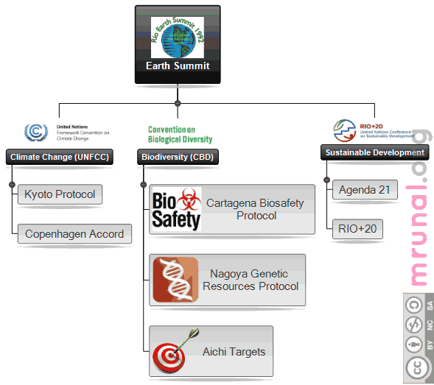
Excursus of Convention on Biological Diversity

Slide 4

Excursus of Convention on Biological Diversity
1992 Rio De Janeiro: CBD Multilateral treaty. Targets:
conservation of biodiversity
sustainable use of its components
fair and equitable sharing of benefits from genetic resources
Different biodiversity policies:
2000 Cartagena protocol (LMO)
2010 Nagoya protocol (ABS) the fair and equitable sharing of benefits arising out of the utilization of genetic resources. Including the Aichi Biodiversity Targets.
2010 UN declared 2011 to 2020 as the United Nations Decade on Biodiversity

Slide 5
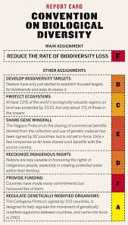
Why does the CBD Strategic Plans fail repeatedly? 1ST Nagoya
“Let us have the courage to look in the eyes of our children and admit that we have failed […] to fulfil the Johannesburg promise made to them by the 110 Heads of State and Government to substantially reduce the loss of biodiversity” Ahmed Djoghlaf, the Executive Secretary of CBD in Nagoya - October 2010-
New policy: the 20 Aichi Targets
WWF living Planet 2018. Mace et al. 2018 Nature sustainability 1:448

Slide 6
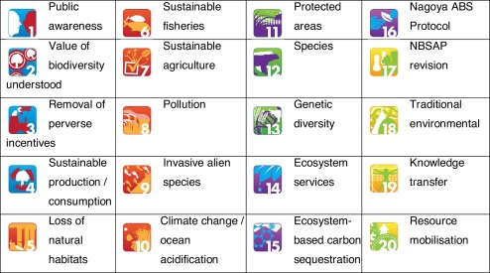
Why does the CBD Strategic Plans fail repeatedly?
Aichi targets in detail

Slide 7
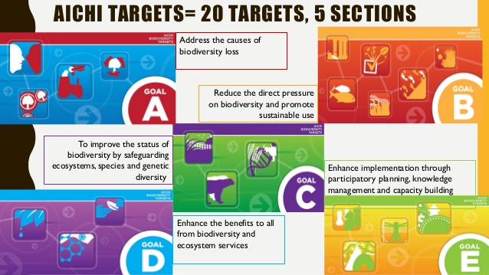
Why does the CBD Strategic Plans fail repeatedly? Aichi targets progresses
60 separate elements to monitor overall progress
7 achieved
38 have shown progress
15 have shown no progress

Slide 8
Reasons of failure: coop at the basis
LACK OF:
Richerzhagen, C. (2011). Effective governance of access and benefit-sharing under the Convention on Biological Diversity. Biodiversity and Conservation, 20(10), 2243–2261.
Adenle, A. A. (2012). Failure to achieve 2010 biodiversity’s target in developing countries: How can conservation help? Biodiversity and Conservation, 21(10), 2435–2442.
Financial resources/
Incentives
Coherent policies
Priority action
Capacity/Knowledge
INTERNATIONAL COOPERATION
Lu, Y., Nakicenovic, N., Visbeck, M., & Stevance, A.-S. (2015). Policy: Five priorities for the UN Sustainable Development Goals. Nature, 520(7548), 432–433. https://doi.org/10.1038/520432a

Slide 9
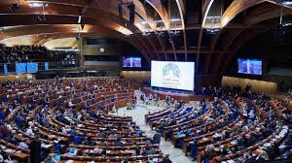
Reasons of failure: science and politics
Failures with regard to the implementation of the Strategic Plan are in many cases not rooted in the Plan itself but in strong forces and power relations that exist independently of the CBD
“the political will is just not there” C. Sendashonga biologist and director of global policy at the IUCN

Slide 10
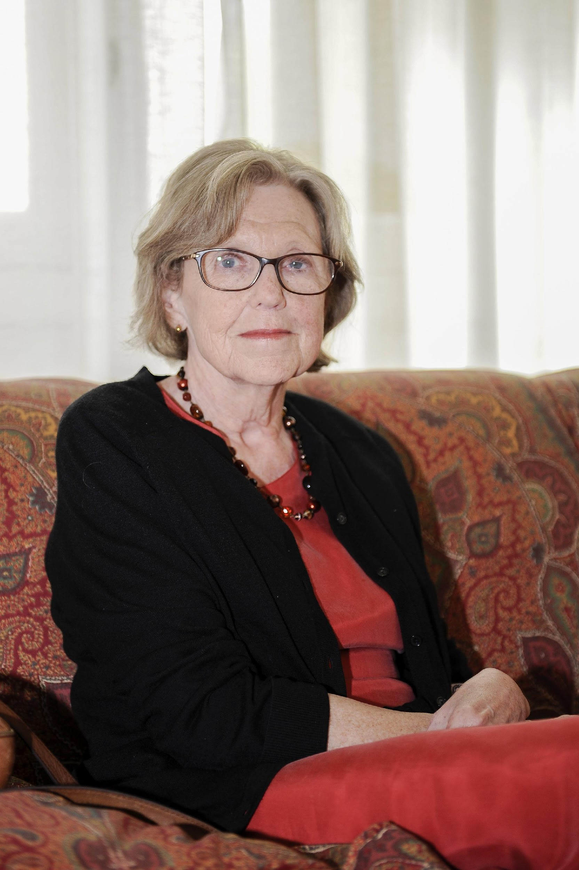
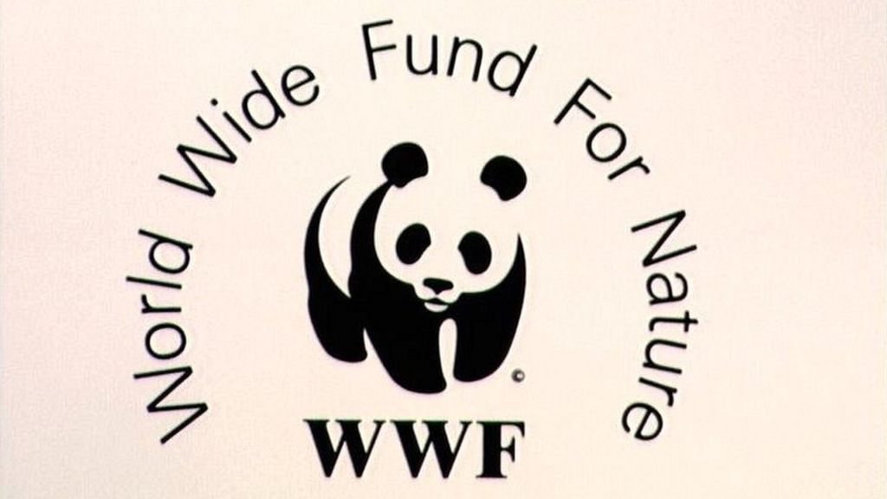
Solution by Georgina Mace/WWF: Bending the biodiversity curve loss – Reviving the CBD
Georgina Mace: British ecologist and conservation scientist.
WWF is one of the world’s largest and most experienced independent conservation organizations. WWF’s mission is to stop the degradation of the planet’s natural environment and to build a future in which humans live in harmony with nature, by conserving the world’s biological diversity, ensuring that the use of renewable natural resources is sustainable, and promoting the reduction of pollution and wasteful consumption.
WWF also adopts Georgina Mace solution to biodiversity loss
Mace, G. M. et al. Aiming higher to bend the curve of biodiversity loss. Nature Sustainability 1: 448-451, doi:10.1038/s41893-018-0130-0 (2018).

Slide 11
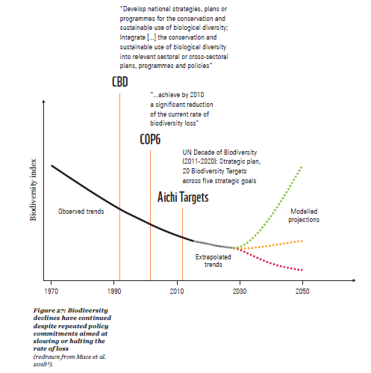
Solution by Georgina Mace/WWF: Bending the biodiversity curve loss – Reviving the CBD
Figure from WWF report page 113

Slide 12
Solution by Georgina Mace/WWF: Bending the biodiversity curve loss – Step 1
1- Translate the aspirational vision to an ambitious goal
The current CBD vision is that “By 2050, biodiversity is valued, conserved, restored and wisely used, maintaining ecosystem services, sustaining a healthy planet and delivering benefits essential for all people.”
The WWF report adopts the same vision and argues to transform it into a goal, not only an aspiration through a new set of targets beyond 2020 to achieve this goal

Slide 13
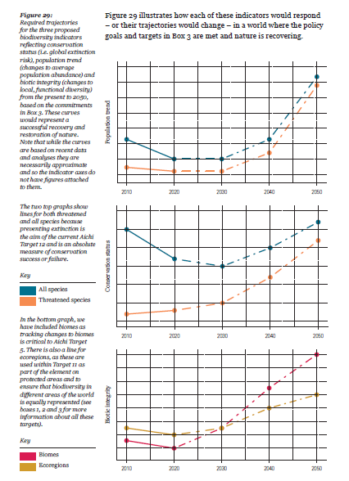
Solution by Georgina Mace/WWF: Bending the biodiversity curve loss – Step 2
2- Identify ways to measure the progress towards the goal
The Living Planet Index (LPI)
The Red List Index
The Biodiversity Intactness Index (BII)
Figure from WWF report: page 119

Slide 14
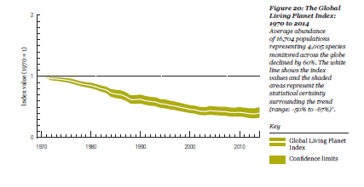
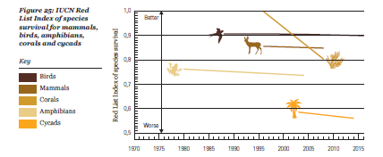
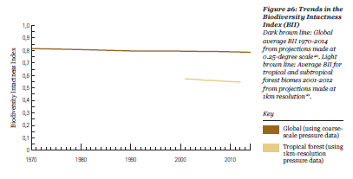
Figures from WWF report: pages: 90 – 105- 106 respectively

Slide 15
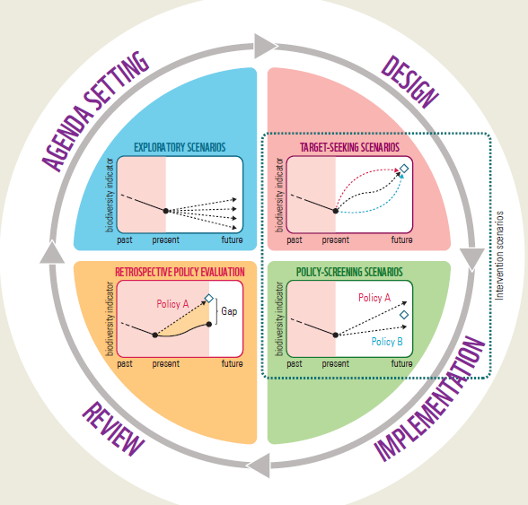
Solution by Georgina Mace/WWF: Bending the biodiversity curve loss – Step 3
3- Identify action to deliver the required transformation in global biodiversity
Scenarios and models can help scientists to visualize and explore how alternative actions affect the dynamic interdependencies between nature, nature’s benefits to people and quality of life.
Figure from WWF report page: 123

Slide 16
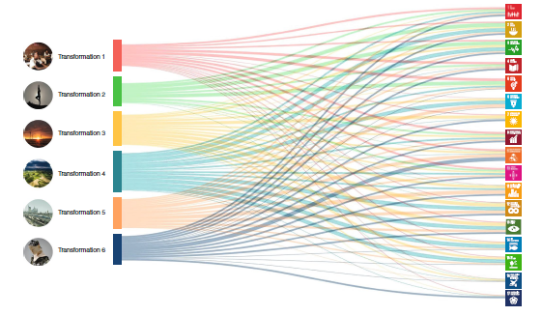
Solution: Six transformations to achieve the SDGs – Focus on partnership as a solution to CBD failure and other future conventions/treaties
This Study provides 6 transformations that needs to be applied through different means to achieve the SDGs
The fourth transformation covers sustainable food, land, water and oceans which is related to biodiversity.
Our Focus in this study is on the goal-based organization of government and financing and Diplomacy and international cooperation for peace, finance and partnerships as well as Social activism to change norms and behaviors.
We notice the importance of partnership is this study to achieve the transformation required. This partnership should be provided both horizontally and vertically.
Figure from Sachs et al. 2019. Six Transformations to achieve the Sustainable Development Goals. Nature Sustainability, 2(9), pp.805-814.
Sachs, J., Schmidt-Tra`ub, G., Mazzucato, M., Messner, D., Nakicenovic, N. and Rockström, J., 2019. Six Transformations to achieve the Sustainable Development Goals. Nature Sustainability, 2(9), pp.805-814.

Slide 17

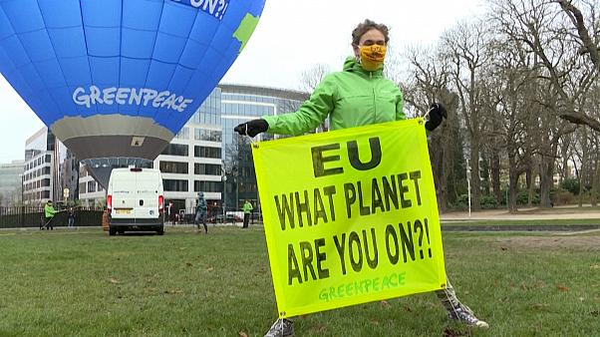
GREENPEACE report on biodiversity loss.
GREENPEACE created a report on the
biodiversity loss and The report stresses the
importance of biodiversity for the SDGs.
The report mentions options, policies and measures to improve the conservation of nature as well as the need for bold decisions, multi-sectoral planning, transformative change and a global sustainable economy.
It also lists key governance interventions, leverage points, recognizes the importance of Indigenous and local people’s rights, knowledge, participation and consent.
Notes:
Greenpeace is a NGO which known for its direct actions. It has been described as one of the most visible environmental organizations in the world.

Slide 18
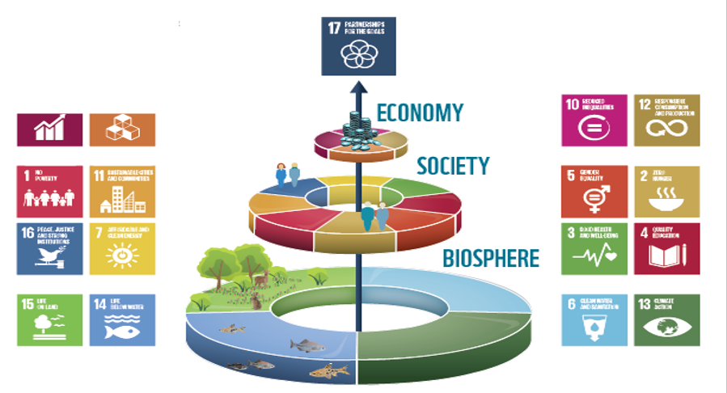
Importance of Partnership
The UN system defines partnerships for the SDGs as follows:
Partnerships for sustainable development are multi-stakeholder initiatives voluntarily undertaken by Governments, intergovernmental organizations, major groups and other stakeholders, which efforts are contributing to the implementation of inter-governmentally, agreed development goals and commitments.
Notes:
To achieve the SDG goals, partnership plays a key role whether it is between government, NGOs, or any Intergovernmental organizations

Slide 19
Importance of Partnership
Partnership of 3 main categories
Leverage / Exchange
Combine / Integrate
Transform
Knowledge, Services, Skills
Cross sector partnerships
To adapt and find solution that is feasible and politically acceptable
1
2
3
Notes:
It is clear that the policy-making framework to help develop strategies and suitable technologies for biodiversity conservation is a complex challenge at the heart of CBD; particularly in getting different governments and intergovernmental organizations together to pursue a common goal.

Slide 20
Access and Benefit-Sharing (ABS)
What is ABS?
Access and benefit-sharing (ABS) refers to the way in which genetic resources may be accessed, and how the benefits that result from their use are shared between the people or countries using the resources (users) and the people or countries that provide them (providers).
Users of genetic resources
Who all are involved ?
Providers of genetic resources
ABS
National Focal Points
Competent National Authorities (CNAs)
Notes:
National Focal Points are responsible for providing the information to users about details in provider countries in order to gain access.
CNAs are bodies established by governments and are responsible for granting access to users of their genetic resources.

Slide 21
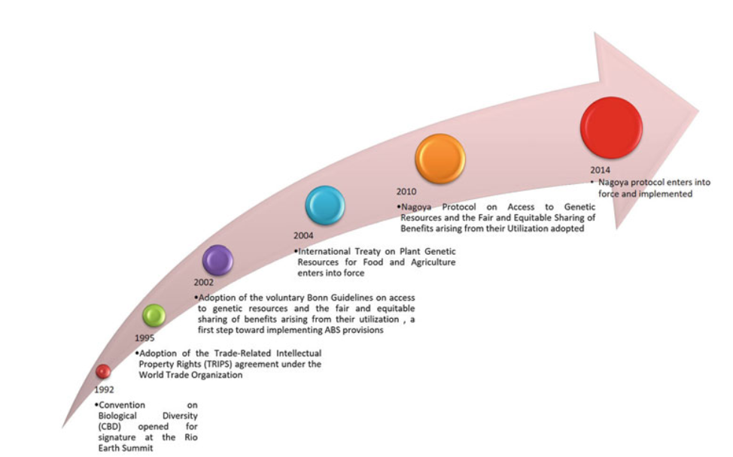
Access and Benefit-Sharing (ABS)
Nagoya Protocol on ABS
This protocol provides a legal framework for the effective implementation of one of the three objectives of the CBD: the fair and equitable sharing of the benefits arising out of the utilization of genetic resources.
Notes:
ABS effectiveness has been questioned in international discussions for many years. It is evident that the approach’s success has fallen far short of what was Expected. The reason for this failure is a lack of incentives.
These shortfalls of ABS can be minimized by designing and allocating rights, manage conservation areas, coordinate activities, negotiate ABS contracts, control compliance, and sanction misappropriation regarding the use of genetic resources. This in turn requires funding for the establishment and maintenance of such institutions. One such Protocol that was introduced was Nagoya Protocol. The Protocol was adopted on 29 October 2010 in Nagoya (Japan) and come into force on 12 October 2014

Slide 22
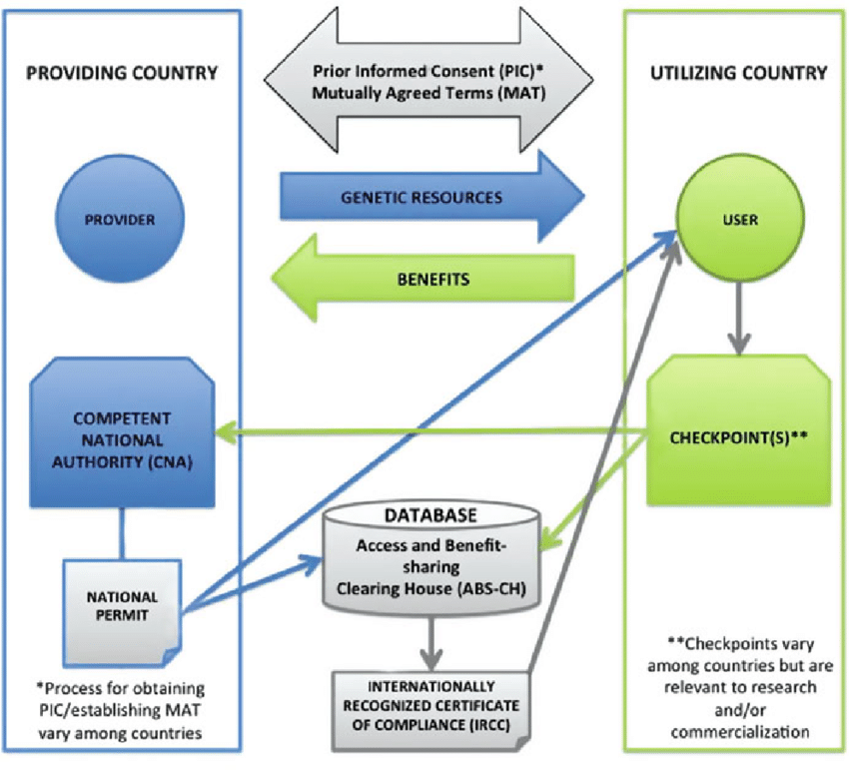
Access and Benefit-Sharing (ABS)
Sharma, S., Singh, S., Ramesh, A., Ahmed, E., & khande, R. (2018). Microbial Genetic Resources: Status, Conservation, and Access and Benefit-Sharing Regulations. Researchgate. https://www.researchgate.net/publication/328684937_Microbial_Genetic_Resources_Status_Conservation_and_Access_and_Benefit-Sharing_Regulations
Notes:
the NP aimed at easing access to countries’ genetic resources and ensuring that potential benefits arising from the use of these resources would be shared with provider countries. Importantly, the CBD and the NP are legal binding agreements, and countries that sign them are obligated to implement their provisions nationally. After NP has come into force, new national laws and regulations providing requirements for access to genetic resources are changing traditional views on collection, deposition and distribution of microorganisms

Slide 23
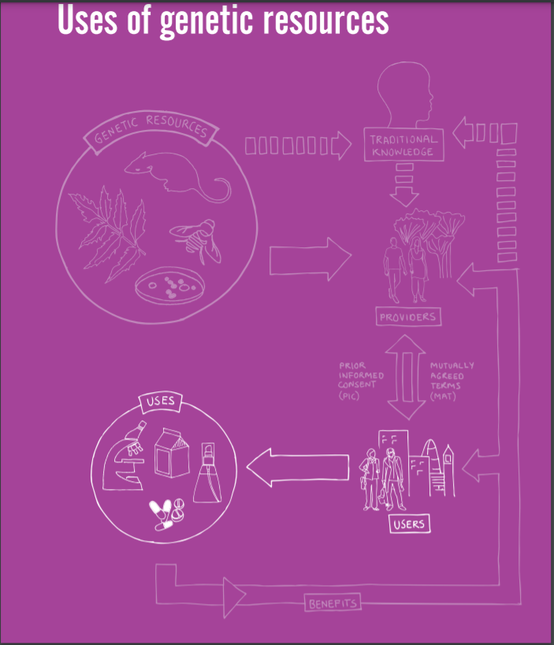
Access and Benefit-Sharing (ABS)
Why genetic resources?
Using genetic resources, whether from plants, animals or microorganisms, refers to the process of researching their beneficial properties and using them to increase scientific knowledge and understanding, or to develop commercial products.
Notes:
Genetic resources are the building blocks of life on earth. By developing our understanding of them, and conserving them, we can improve conservation of threatened species, and the communities who depend on them.

Slide 24
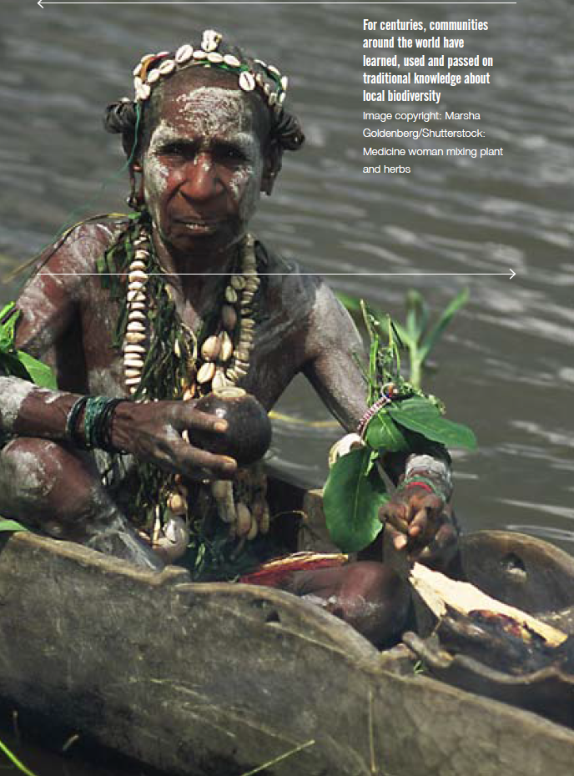
Traditional Knowledge and Indigenous Communities
Traditional knowledge refers to the knowledge, innovations and practices of indigenous and local communities (ILCs) related to genetic resources. This traditional knowledge is developed through the experiences of communities
over centuries, adapted to local needs, cultures and
environments and passed down from generation to
generation.
Notes:
Indigenous peoples and other in situ communities manage lands and seas that hold significant portions of the planet’s biodiversity and carbon stocks. In addition, place-based communities have generated creative resilient responses to global pressures, despite experiencing outsized impacts from them.

Slide 25
Conclusions
International collaborations between governments and public and private researchers are essential for optimizing resource use and sharing knowledge.
Public opinion is important to keep the government inclined towards fulfilling the biodiversity goals.
Research and development support programs are needed to encourage global collaborations in a few breakthrough projects.
The solution provided by Georgina Mace adopted by WWF report as well as the study of Sachs et al. should be implemented also to achieve the biodiversity goals.
Educators should collaborate internationally to define the knowledge, skills and competencies required for developing a bioeconomy that enhances the sustainable use of bio-based materials
ABS market approach should be taken up by providing incentives and modifying it according to specific needs.
Country government should encourage the use of ABS approach and it should be directed towards identifying and promoting indigenous technologies within local communities.
To ensure successful achievement of the Aichi targets in 2020, considerable effort will be required from the international community and national governments through prioritizing technological innovation investments, funding and implementing biodiversity policies from local to national government, promoting education and awareness creation among wider community, especially women and youth.

Slide 26
References
Adenle, A. A. (2012). Failure to achieve 2010 biodiversity’s targeting developing countries: How can conservation help? https://www.researchgate.net/publication/257537512_Failure_to_achieve_2010_biodiversity’s_target_in_developing_countries_How_can_conservation_help
Sterling, E.J., Filardi, C., Toomey, A. et al. Biocultural approaches to well-being and sustainability indicators across scales. Nat Ecol Evol 1, 1798–1806 (2017).
https://doi.org/10.1038/s41559-017-0349-6
El-Chichakli, B., Barben, D., Lang, C., von Braun, J., & Philp, J. (2016). Policy: Five cornerstones of a global bioeconomy.
https://www.nature.com/news/policy-five-cornerstones-of-a-global-bioeconomy-1.20228
Richerzhagen, C. (2011). Effective governance of access and benefit-sharing under the Convention on Biological Diversity. Biodiversity and Conservation, 20(10), 2243–2261.
Sachs, J., Schmidt-Traub, G., Mazzucato, M., Messner, D., Nakicenovic, N. and Rockström, J., 2019. Six Transformations to achieve the Sustainable Development Goals. Nature Sustainability, 2(9), pp.805-814.
WWF Living Planet 2018. Mace et al. 2018 Nature Sustainability 1: 448
Adenle, A. A. (2012). Failure to achieve 2010 biodiversity’s target in developing countries: How can conservation help? Biodiversity and Conservation, 21(10), 2435–2442.
Lu, Y., Nakicenovic, N., Visbeck, M., & Stevance, A.-S. (2015). Policy: Five priorities for the UN Sustainable Development Goals. Nature, 520(7548), 432–433. https://doi.org/10.1038/520432a

Slide 27
Thank you

